Slide 2
There are 4 rails: A, B, C, D
On each rail, there are 2 robots (white blocks)
Each rail has 16 position: from 0 (the tail of the arrow) to 15 (arrowhead)
The left and the right are indicated by the arrow’s direction.
Rail D
Position 0
Position 15
Rail B
Position 15
Position 0
Position 0
Rail A
Position 15
Position 15
Position 0
Rail C

Slide 3
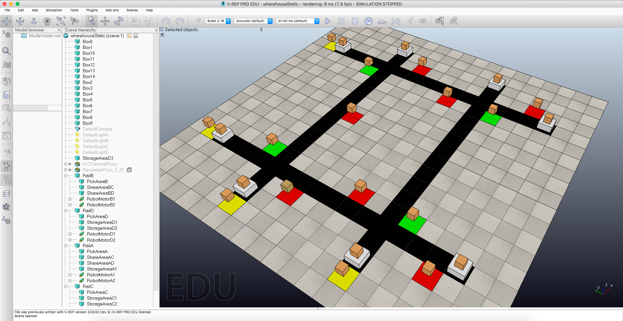
The green areas are the share areas, the yellow ones are the pick areas and the red areas are the storage areas.
The robots on position 0 are: A1, B1, C1 and D1, instead the robots on position 15 are A2, B2, C2 and D1. The letter indicates the rail.
Play/Pause/Stop the simulation
Robot A2
PickAreaC
ShareAreaAC
ShareAreaBC
BoxA1
Robot A1
StorageAreaC1
BoxB2
RobotB2

Slide 4
To open the scene:
File -> open scene
Select the warehouseStatic.ttt situated in the vrepFiles in the unzipped folder
To run the program use JACK.
After the execution of the program, it will be opened 3 GUI in v-rep as showed in the next slide.
The bigger one is used to move the robot in the environment (moveForeward, moveBackward and stop) and to load unload. It show what the robot data, what it has on his left and right and the other rail crossed.
The smaller one is the timer used to stop, pause and play the program. You can also using the three button in v-rep.
The other one is used to add/remove boxes from the various areas.

Slide 5
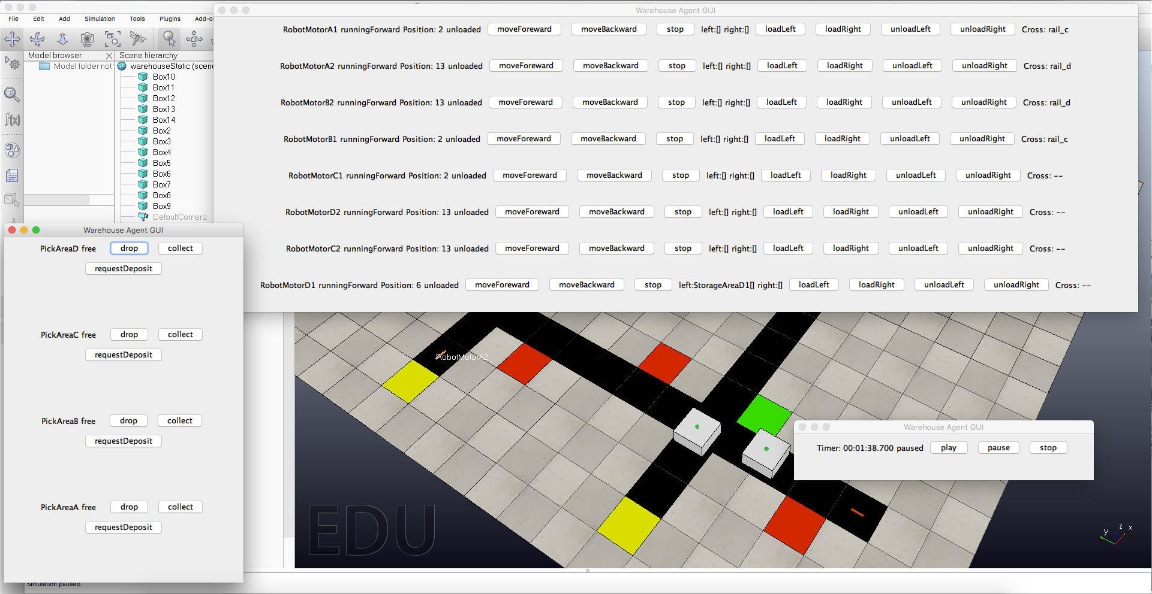
Robot Data
Move the robot
What’s on his left/right
Load/Unload
Other rail crossed
Add or remove boxes
Timer

